Slide 1


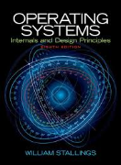
Welcome to
CS 345 Operating Systems
Concurrency, Chapter 6 (15)

Slide 2
Tip #15: “goes to” Operator -->
2
int main()
{
int x = 10;
while( x --> 0 ) // x goes to 0
{
printf("%d ", x);
}
printf("\n");
}
9 8 7 6 5 4 3 2 1 0
Actually --> is not an operator!
It’s a combination of two separate operators, i.e. -- and >.
The conditional code decrements variable x, which returns x’s original (not decremented) value, and then compares the original value with 0 using the > operator.

Slide 3
Conditions of Deadlock
Necessary (but not sufficient)
Mutual exclusion – Everyone abides by the rules
only one process may use a resource at a time.
no process may access resource allocated to another.
Hold-and-wait
a process may hold allocated resources while awaiting assignment of other resources.
No preemption
no resource can be forced to free a resource.
Circular wait (sufficient)
a closed chain of processes exists, such that each process holds at least one resource needed by the next process in the chain (consequence of the first three conditions)
Other conditions are necessary but not sufficient for deadlock - all four conditions must hold for deadlock - Unresolvable circular wait is the definition of deadlock!
Notes:
3

Slide 4
Handling Deadlock
Four general approaches exist for dealing with deadlock.
Prevent deadlock
by adopting a policy that eliminates one of the conditions.
Avoid deadlock
by making the appropriate dynamic choices based on the current state of resource allocation.
Detect Deadlock
by checking whether conditions 1 through 4 hold and take action to recover.
Ignore Deadlock
System may hang, so??
Notes:
4

Slide 5
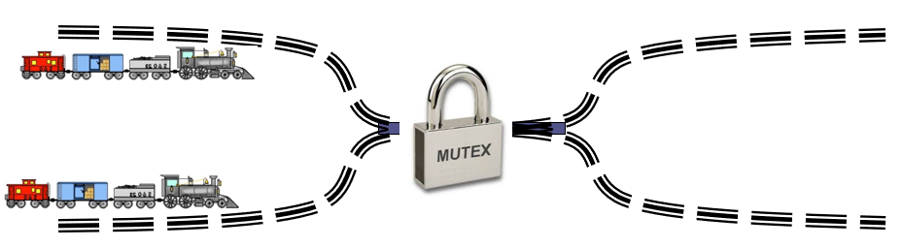
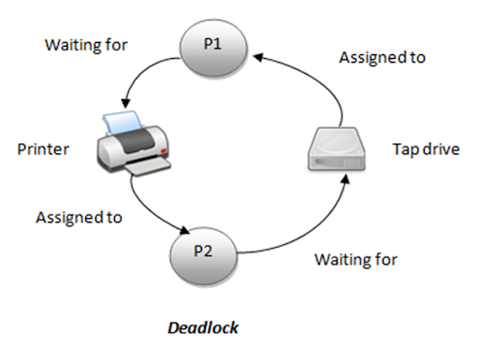
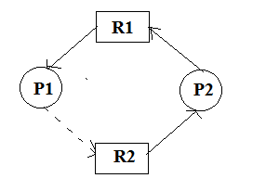
1. Prevent Deadlock
Eliminate Mutual Exclusion
Use non-sharable resources
Eliminate Hold and wait
Guarantee that when a process requests a resource, it does not hold any other resources
System calls requesting resources precede all others
A process can only request resources when it has none
Usually results in low utilization of resources
Allow Preemption
If a process holds resources and requests more that cannot be allocated, all its other resources are preempted
If you can’t hold all, you can’t hold any
Process is restarted only when it can have all
Works for resources whose state can be easily saved and restored later such as registers or memory.
Notes:
5

Slide 6
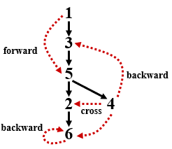
1. Prevent Deadlock
Eliminate Circular Wait
Impose a total ordering of all resources (transitivity, antisymmetry)
Require that all processes request resources in increasing order.
Whenever a process requests a resource, it must release all resources that are lower
With this rule, the resource allocation graph can never have a cycle.
May be impossible to find an ordering that satisfies everyone
Put resources in topological order.
1 ≡ Card reader
2 ≡ Printer
3 ≡ Plotter
4 ≡ Tape drive
5 ≡ Card punch
Processes request resources anytime but must be made in numerical order.
A process may request first printer and then a tape drive (order: 2, 4), but not a plotter and then a printer (order: 3, 2).
Notes:
6

Slide 7
Applications
Cycles
A directed graph G is cyclic iff G has a backward edge.
This implies cycle detection can be done in O(m) (O(n²) in worst case for a complete graph), which beats O(n³) in Warshall’s algorithm.

Slide 8
Applications (continued…)
Topological Sorting (if acyclic)
Recall that partial orders and Hasse diagrams are acyclic graphs. (No node in a path is repeated.)
A topological sort of a partial order ∠ over A (an acyclic directed graph) is an ordering of the elements (of V) such that x precedes y if x ∠ y (y is reachable from x.)
Algorithm: List the nodes in reverse post-order (ie. push nodes on a stack whenever we assign a post-order number, then pop off.)

Slide 9
Exercise: Topological Sorting (continued…)
Problem: Put in topological order.
all arrows to the right
single line w/no loops
a
e
b
c
1. Start with node a (could be alphabetic, forward, backward, random – just use order in adjacency list), do DFS.
f
d
2. Put in post-order numbers (start w/left most tree and push on stack.)
a
b
c
f
a
b
(6)
(1)
e
d
c
f
(3)
(5)
e
(2)
d
(4)

Slide 10
Topological Sorting (continued…)
Problem: Put in topological order.
all arrows to the right
single line w/no loops
a
e
b
c
3. List nodes in reverse post-order (pop off stack.)
f
d
a
b
(6)
(1)
c
f
b₆ f₅ d₄ c₃ e₂ a₁
(3)
(5)
e
(2)
d
(4)
Topological sort of an acyclic graph: b,f,d,c,e,a
– everything goes to the right!
Thus x →y, P(x) > P(y)

Slide 11
6
cross
1
3
5
2 4
6
5
2 4
3
1
backward
cross
forward
cross
cross
backward
cross
backward
cross
backward

Slide 12
*** The Interpreters ***
Have you ever had to work your way through a maze of interpreters at an international conference? If so, you will have had useful practice for overcoming the language difficulty at the Great World Conference, whose vital importance may be measured by these portraits of the interpreters engaged for it.
The Swedish and Indonesian delegates wish to talk to each other, but among the sixteen interpreters, not one speaks both Swedish and Indonesian. The only way round this problem is to form a chain of interpreters.

Slide 13
*** The Interpreters ***
For example, an English-French interpreter could talk to a French-Italian interpreter who in turn could speak to an Italian Spanish Interpreter and so on…
Each interpreter, however, must have a booth of his own, and there are only four booths available.
Problem: Which four interpreters will you place in the booths so that the Swedish and Indonesian delegates can talk to each other? The Interpreters both speak and understand the languages listed next to their respective numbers.

Slide 14
*** The Great World Conference ***
Swedish—( |  | Booth #1 | Booth #2 | Booth #3 | Booth #4 | )—Indonesian
(1) Portuguese Indonesian | (2) Polish English German | (3) Italian Norwegian English | (4) Korean Turkish | (5) English Polish | (6) Swedish Turkish | (7) Spanish Chinese Japanese | (8) French Portuguese
(9) Dutch German | (10) Swedish Norwegian | (11) Japanese Indonesian Russian | (12) Dutch French Chinese Russian Portuguese | (13) Polish Italian Swedish | (14) German Chinese Korean | (15) Dutch Spanish Indonesian | (16) French English

Slide 15
*** The Great World Conference ***
 | A | 1 | 2 | 3 | 4 | 5 | 6 | 7 | 8 | 9 | 10 | 11 | 12 | 13 | 14 | 15 | 16 | B
Chinese |  |  |  |  |  |  |  | 1 |  |  |  |  | 1 |  | 1
Dutch |  |  |  |  |  |  |  |  |  | 1 |  |  | 1 |  |  | 1 | 1
English |  |  | 1 | 1 |  | 1 |  |  |  |  |  |  |  |  |  |  | 1
French |  |  |  |  |  |  |  |  | 1 |  |  |  | 1 |  |  |  | 1
German |  |  | 1 |  |  |  |  |  |  | 1 |  |  |  |  | 1
Indonesian |  | 1 |  |  |  |  |  |  |  |  |  | 1 |  |  |  | 1 |  | 1
Italian |  |  |  | 1 |  |  |  |  |  |  |  |  |  | 1
Japanese |  |  |  |  |  |  |  | 1 |  |  |  | 1
Korean |  |  |  |  | 1 |  |  |  |  |  |  |  |  |  | 1
Norwegian |  |  |  | 1 |  |  |  |  |  |  | 1
Polish |  |  | 1 |  |  | 1 |  |  |  |  |  |  |  | 1
Portuguese |  | 1 |  |  |  |  |  |  | 1 |  |  |  | 1
Russian |  |  |  |  |  |  |  |  |  |  |  | 1 | 1
Spanish |  |  |  |  |  |  |  | 1 |  |  |  |  |  |  |  | 1
Swedish | 1 |  |  |  |  |  | 1 |  |  |  | 1 |  |  | 1
Turkish |  |  |  |  | 1 |  | 1

Slide 16
*** The Great World Conference ***
 | A | 1 | 2 | 3 | 4 | 5 | 6 | 7 | 8 | 9 | 10 | 11 | 12 | 13 | 14 | 15 | 16 | B
A | 0 | 0 | 0 | 0 | 0 | 0 | 1 | 0 | 0 | 0 | 1 | 0 | 0 | 1 | 0 | 0 | 0 | 0
1 | 0 | 0 | 0 | 0 | 0 | 0 | 0 | 0 | 1 | 0 | 0 | 1 | 1 | 0 | 0 | 1 | 0 | 1
2 | 0 | 0 | 0 | 0 | 0 | 1 | 0 | 0 | 0 | 1 | 0 | 0 | 0 | 1 | 1 | 0 | 0 | 0
3 | 0 | 0 | 0 | 0 | 0 | 1 | 0 | 0 | 0 | 0 | 1 | 0 | 0 | 1 | 0 | 0 | 1 | 0
4 | 0 | 0 | 0 | 0 | 0 | 0 | 1 | 0 | 0 | 0 | 0 | 0 | 0 | 0 | 1 | 0 | 0 | 0
5 | 0 | 0 | 1 | 1 | 0 | 0 | 0 | 0 | 0 | 0 | 0 | 0 | 0 | 1 | 0 | 0 | 1 | 0
6 | 1 | 0 | 0 | 0 | 1 | 0 | 0 | 0 | 0 | 0 | 1 | 0 | 0 | 1 | 0 | 0 | 0 | 0
7 | 0 | 0 | 0 | 0 | 0 | 0 | 0 | 0 | 0 | 0 | 0 | 1 | 1 | 0 | 1 | 1 | 0 | 0
8 | 0 | 1 | 0 | 0 | 0 | 0 | 0 | 0 | 0 | 0 | 0 | 0 | 1 | 0 | 0 | 0 | 1 | 0
9 | 0 | 0 | 1 | 0 | 0 | 0 | 0 | 0 | 0 | 0 | 0 | 0 | 1 | 0 | 1 | 1 | 0 | 0
10 | 1 | 0 | 0 | 1 | 0 | 0 | 1 | 0 | 0 | 0 | 0 | 0 | 0 | 0 | 0 | 0 | 0 | 0
11 | 0 | 1 | 0 | 0 | 0 | 0 | 0 | 1 | 0 | 0 | 0 | 0 | 1 | 0 | 0 | 1 | 0 | 1
12 | 0 | 1 | 0 | 0 | 0 | 0 | 0 | 1 | 1 | 1 | 0 | 1 | 0 | 0 | 1 | 1 | 1 | 0
13 | 1 | 0 | 1 | 1 | 0 | 1 | 1 | 0 | 0 | 0 | 0 | 0 | 0 | 0 | 0 | 0 | 0 | 0
14 | 0 | 0 | 1 | 0 | 1 | 0 | 0 | 1 | 0 | 1 | 0 | 0 | 1 | 0 | 0 | 0 | 0 | 0
15 | 0 | 1 | 0 | 0 | 0 | 0 | 0 | 1 | 0 | 1 | 0 | 1 | 1 | 0 | 0 | 0 | 0 | 1
16 | 0 | 0 | 0 | 1 | 0 | 1 | 0 | 0 | 1 | 0 | 0 | 0 | 1 | 0 | 0 | 0 | 0 | 0
B | 0 | 1 | 0 | 0 | 0 | 0 | 0 | 0 | 0 | 0 | 0 | 1 | 0 | 0 | 0 | 0 | 0 | 0

Slide 17
2. Avoid Deadlock
Allow general requests, but grant only when safe
Assume we know the maximum requests (claims) for each process
Process must state it needs
Ie. max of 5 A objects, 3 B objects, 2 C objects.
Do not need to use its max claims
Ie. Ok to set max=5 and only use 3
Can make requests at any time and in any order
Process Initiation Denial
Track current allocations
Assume all processes may make maximum requests at the same time
Only start process if it can’t result in deadlock regardless of allocations
Notes:
17

Slide 18
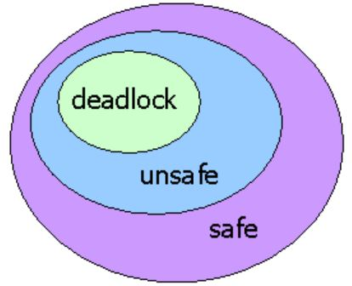
Resource Allocation Denial
Safe State – We can finish all processes by some scheduling sequence
Example: Finish P1, P4, P2, P5, P3
Banker’s Algorithm (Dijkstra)
Reject a request if it exceeds the
processes’ declared maximum claims
Grant a request if the new state would be safe
Determining if a state is safe
Find any process P_{i} for which we can meet it’s maximum requests
Don't forget already allocated resources
Mark P_{i} as “done”, add its resources to available resource pool
State is safe if we can mark all processes as “done”
Block a process if the resources are not currently available or the new state is not safe
Notes:
18

Slide 19
Banker’s Algorithm Example
Claim
Allocation
Allocation
C - A
 | A | B | C
P₁ | 3 | 2 | 2
P₂ | 6 | 1 | 3
P₃ | 3 | 1 | 4
P₄ | 4 | 2 | 2
A
A
B
C
A
B
B
C
C
P₁
P₁
2
2
2
P₁
1
1
0
0
0
0
P₂
P₂
1
0
2
P₂
5
5
1
1
1
1
P₃
P₃
1
0
3
P₃
2
2
1
1
1
1
P₄
P₄
4
2
0
P₄
0
0
0
0
2
2
Resource
A | B | C
9 | 3 | 6
Available
A | B | C
1 | 1 | 2
6 | 2 | 3
Are we in a safe state?
Yes!

Slide 20
XYZ Carpentry
Carpentry Company XYZ has 4 employees, 9 clamps, 2 drills, and 2 bottles of glue.
Chair 4 clamps, 1 drill
Desk 6 clamps, 1 drill, 1 glue
Picture Frame 4 clamps, 1 drill, 1 glue
Book Case 6 clamps, 1 drill, 1 glue

Slide 21
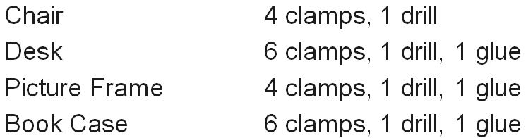
XYZ Carpentry
Claim
Allotted
Needed
 | Clamp | Drill | Glue
P₁ | 4 | 1 | 0
P₂ | 6 | 1 | 1
P₃ | 4 | 1 | 1
P₄ | 6 | 1 | 1
 | Clamp | Drill | Glue
P₁ | 1 | 0 | 0
P₂ | 2 | 0 | 1
P₃ | 2 | 1 | 0
P₄ | 2 | 0 | 0
A
B
C
P₁
3
1
0
P₂
4
1
0
P₃
2
0
1
P₄
4
1
1
Resource
Clamp | Drill | Glue
9 | 2 | 2
Available
Clamp | Drill | Glue
2 | 1 | 1
4 | 2 | 1
Yes!
1. Are we in a safe state?
2. P₁ needs a drill. Is it OK to give it to him?
3. Then, P₄ needs a glue. Would you give it to him?

Slide 22
XYZ Carpentry
Claim
Allotted
Needed
 | Clamp | Drill | Glue
P₁ | 4 | 1 | 0
P₂ | 6 | 1 | 1
P₃ | 4 | 1 | 1
P₄ | 6 | 1 | 1
 | Clamp | Drill | Glue
P₁ | 1 | 1 | 0
P₂ | 2 | 0 | 1
P₃ | 2 | 1 | 0
P₄ | 2 | 0 | 0
A
B
C
P₁
3
0
0
P₂
4
1
0
P₃
2
0
1
P₄
4
1
1
Resource
Clamp | Drill | Glue
9 | 2 | 2
Available
Clamp | Drill | Glue
2 | 0 | 1
4 | 2 | 1
Yes!
1. Are we in a safe state?
2. P₁ needs a drill. Is it OK to give it to him?
3. Then, P₄ needs a glue. Would you give it to him?
Yes!

Slide 23
XYZ Carpentry
Claim
Allotted
Needed
 | Clamp | Drill | Glue
P₁ | 4 | 1 | 0
P₂ | 6 | 1 | 1
P₃ | 4 | 1 | 1
P₄ | 6 | 1 | 1
 | Clamp | Drill | Glue
P₁ | 1 | 1 | 0
P₂ | 2 | 0 | 1
P₃ | 2 | 1 | 0
P₄ | 2 | 0 | 0
A
B
C
P₁
3
0
0
P₂
4
1
0
P₃
2
0
1
1
P₄
4
1
1
0
Resource
Clamp | Drill | Glue
9 | 2 | 2
Available
Clamp | Drill | Glue
2 | 0 | 1
2 | 0 | 0
1. Are we in a safe state? Yes
2. P₁ needs a drill. Is it OK to give it to him? Yes
3. Then, P₄ needs a glue. Would you give it to him?
No!

Slide 24
3. Detect Deadlock
24
Avoidance methods tend to limit access to resources
Instead, grant arbitrary requests and watch for deadlock
Can vary how often we check
Early detection vs. overhead of checks
Algorithm (Stallings, Figure 6.9)
Preparation:
Create table of process requests, current allocations
Note available resources
Mark processes with no resources
Mark any process whose requests can be met (requests ≤ available resources)
Include resources from that process as ‘available’ (this process can finish)
If multiple processes available, pick any
If any processes cannot be marked, they are part of a deadlock
Notes:
24

Slide 25
Detection Example
25
Request
Allocation
Resource
 | A | B | C | D | E
P₁ | 0 | 1 | 0 | 0 | 1
P₂ | 0 | 0 | 1 | 0 | 1
P₃ | 0 | 0 | 0 | 0 | 1
P₄ | 1 | 0 | 1 | 0 | 1
 | A | B | C | D | E
P₁ | 1 | 0 | 1 | 1 | 0
P₂ | 1 | 1 | 0 | 0 | 0
P₃ | 0 | 0 | 0 | 1 | 0
P₄ | 0 | 0 | 0 | 0 | 0
A | B | C | D | E
2 | 1 | 1 | 2 | 1
Available
A | B | C | D | E
0 | 0 | 0 | 0 | 1
A
B
C
D
E
Temporary Available
0
0
0
0
1
0
0
0
1
1
Mark P₄ (not holding anything someone else wants)
Mark P₃, new available: 0 0 0 1 1
Cannot mark P₁ or P₂, so we are deadlocked

Slide 26
Deadlocked?
26
Requests
Allocation
Resource
 | A | B | C
P₁ | 0 | 0 | 0
P₂ | 2 | 0 | 2
P₃ | 0 | 0 | 0
P₄ | 1 | 0 | 0
P₅ | 0 | 0 | 2
 | A | B | C
P₁ | 0 | 1 | 0
P₂ | 2 | 0 | 0
P₃ | 3 | 0 | 3
P₄ | 2 | 1 | 1
P₅ | 0 | 0 | 2
A | B | C
7 | 2 | 6
Available
A | B | C
0 | 0 | 0
A
B
C
Temporary Available
0
0
0
Are we deadlocked? (Why or why not?)

Slide 27
Deadlocked?
27
Requests
Allocation
Resource
 | A | B | C
P₁ | 0 | 0 | 0
P₂ | 2 | 0 | 2
P₃ | 0 | 0 | 0
P₄ | 1 | 0 | 0
P₅ | 0 | 0 | 2
 | A | B | C
P₁ | 0 | 1 | 0
P₂ | 2 | 0 | 0
P₃ | 3 | 0 | 3
P₄ | 2 | 1 | 1
P₅ | 0 | 0 | 2
A | B | C
7 | 2 | 6
Available
A | B | C
0 | 0 | 0
A
B
C
Temporary Available
5
7
7
1
2
2
3
4
0
6
3
1
1
0
0
0
3
0
Are we deadlocked?
No

Slide 28
Deadlock Recovery
28
Several possible approaches
Abort all deadlocked processes
Simple but common
Back up processes to a previously saved checkpoint, then restart
Assumes we have checkpoints and a rollback mechanism
Runs risk of repeating deadlock
Assumes that the deadlock has enough timing dependencies it won’t happen
Selectively abort processes until deadlock broken
Preempt resources until deadlock broken
Must roll back process to checkpoint prior to acquiring key resource
Notes:
28

Slide 29
Deadlock Recovery
29
Process Termination
Kill them all
One at a time
Consider priority
Time computing
Who has most resources
Resource Preemption
Who gets preempted
Do you consider process rollback and starvation
Notes:
29

Slide 30
4. Ignore Deadlock
30
Perhaps not as silly as it sounds - since handling deadlock has a very high cost, it might be better to ignore it.
Usually, the OS assumes that even if deadlock occurs, the loss of data will be minimal and the probability of occurrence of such a situation is very low.
Use resource prioritization for heavily used resources, otherwise, don’t worry about deadlock.
Handling deadlock requires an algorithm constantly running in background - is 20% of the CPU time worth trying to prevent an event with a probability of occurrence less than 0.01%?
If the alternative is to have a forced reboot once a year, that might be acceptable.
When is ignoring deadlock unacceptable?
Notes:
30

Slide 31
Handling Deadlock Strategies
31
Questions:
Does prevention/avoidance/detection really work?
How often should you run a detection process?
How often is deadlock likely to occur?
How expensive is a detection process?
May group resources into classes and have different deadlock strategies for each class. Examples:
Swap Space - Prevent deadlocks by requiring all space to be allocated at once. (Avoidance also possible.)
Tapes/Files - Avoidance can be effective here, but prevention by ordering resources also possible.
Main Memory - Preemption a good approach
Internal Resources (channels, etc.) - Prevention by ordering resources
Notes:
31

Slide 32
Advantages/Disadvantages
32
Approach | Allocation Policy | Scheme | Advantages | Disadvantages
Prevention | Conservative; under commits resources | Requesting all resources at once | Works well for process that perform a single burst of activity No preemption necessary | Inefficient Delays process initiation Future resource requirements must be known by processes
 |  | Preemption | Convenient when applied to resources whose state can be saved and restored easily | Preempts more often than necessary
 |  | Resource ordering | Feasible to enforce via compile-time checks Needs no run-time computation since problem is solved in system design | Disallows incremental resource requests
Avoidance | Burden on system analysist; Midway between detection and prevention | Manipulate to find at least one safe path | No preemption necessary | Future resource requirements must be known by OS Processes can be blocked for long periods
Detection | Very liberal; requested resources are granted where possible | Invoke periodically to test for deadlock | Never delays process initiation Facilitates online handling | Inherent preemption losses
Ignorance | Extremely liberal; requested resources are always granted | Infrequent deadlock acceptable | No CPU overhead | Not safety critical Inherent preemption losses

Slide 33
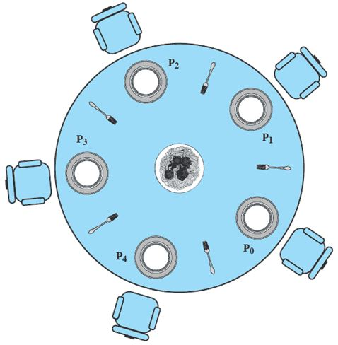
The Dining Philosophers Problem
33
5 philosophers who only eat and think.
Each need to use 2 forks for eating.
There are only 5 forks.
1. When only two philosophers are eating, are we in a safe state?
2. Is deadlock possible?
3. How can deadlock be prevented?

Slide 34
Two Philosophers Eating
34
Claim
Allocated
C - A
 | A | B | C | D | E
P₁ | 1 | 1 | 0 | 0 | 0
P₂ | 0 | 1 | 1 | 0 | 0
P₃ | 0 | 0 | 1 | 1 | 0
P₄ | 0 | 0 | 0 | 1 | 1
P₅ | 1 | 0 | 0 | 0 | 1
 | A | B | C | D | E
P₁ | 1 | 1 | 0 | 0 | 0
P₂ | 0 | 0 | 0 | 0 | 0
P₃ | 0 | 0 | 1 | 1 | 0
P₄ | 0 | 0 | 0 | 0 | 0
P₅ | 0 | 0 | 0 | 0 | 0
 | A | B | C | D | E
P₁ | 0 | 0 | 0 | 0 | 0
P₂ | 0 | 1 | 1 | 0 | 0
P₃ | 0 | 0 | 0 | 0 | 0
P₄ | 0 | 0 | 0 | 1 | 1
P₅ | 1 | 0 | 0 | 0 | 1
Resources
Available
A | B | C | D | E
1 | 1 | 1 | 1 | 1
A | B | C | D | E
0 | 0 | 0 | 0 | 1
1
1
1
1
1
1
1
0
0
1
Yes
Two philosophers are eating. Are we in a safe state?

Slide 35
Are the Philosophers Starving?
35
Request
Allocation
Resource
 | A | B | C | D | E
P₁ | 0 | 1 | 0 | 0 | 0
P₂ | 0 | 0 | 1 | 0 | 0
P₃ | 0 | 0 | 0 | 1 | 0
P₄ | 0 | 0 | 0 | 0 | 1
P₅ | 1 | 0 | 0 | 0 | 0
 | A | B | C | D | E
P₁ | 1 | 0 | 0 | 0 | 0
P₂ | 0 | 1 | 0 | 0 | 0
P₃ | 0 | 0 | 1 | 0 | 0
P₄ | 0 | 0 | 0 | 1 | 0
P₅ | 0 | 0 | 0 | 0 | 1
A | B | C | D | E
1 | 1 | 1 | 1 | 1
Available
A | B | C | D | E
0 | 0 | 0 | 0 | 0
A
B
C
D
E
Temporary Available
0
0
0
0
0
Yes
No philosophers are eating. Are we deadlocked?

Slide 36
Solution??
36
Each philosopher is a process.
One semaphore per fork:
forks: array[0..4] of semaphores
Initialization: forks[i].count:=1 for i:=0..4
Process Pi:
repeat
think;
wait(forks[i]);
wait(forks[(i+1)%5]);
eat;
signal(forks[(i+1)%5]);
signal(forks[i]);
forever
Deadlock if each philosopher starts by picking left fork!
Notes:
Philosophers eat and think for a random amount of time.
(They are not self-aware. ha ha)
Can’t proceed if my right fork has been picked up.
Mutual exclusion
Bounded wait problem
Progress
Possible Solutions:
Only one allowed to pick up forks. If not available, put back down. (All or nothing)
2. Only allow four people to pick up – guarantees at least one to succeed.

Slide 37
Another Solution
37
A solution: admit only 4 philosophers at a time that tries to eat
Then 1 philosopher can always eat when the other 3 are holding 1 fork
Introduce semaphore T that limits to 4 the number of philosophers “sitting at the table”
Initialize: T.count:=4
Process Pi:
repeat
think;
wait(T);
wait(forks[i]);
wait(forks[(i+1)%5]);
eat;
signal(forks[(i+1)%5]);
signal(forks[i]);
signal(T);
forever
Notes:
T allows only 4 people in.
Maybe not the most efficient

Slide 38
Other Solutions…
38
Concurrenty (15)
Buy more Forks
Equivalent to increasing resources
Put fork down if 2nd fork busy
“livelock” if philosophers stay synchronized
Room Attendant
Only let 4 of the philosophers into the room at once
May have 4 philosophers in room, but only 1 can eat
Left-Handed Philosophers (asymmetric solution)
Grab forks in the other order (right fork, then left fork)
Any mix will avoid deadlock (linear ordering on forks)
A philosopher may only pick up forks in pairs.
must allocate all resources at once

Slide 39
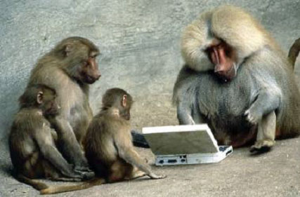

Be Safe

